Slide 1
Managing Professional Risks
Through Networks
Social Capital and Women's Achievement
in Ancient China
Weifeng Liu
February 25, 2025
Notes:
Good afternoon everyone. Today I will talk about Managing Professional Risks Through Networks, this is aimed to analysis women's networks in ancient China and how they used social capital for literary achievement.

Slide 2
Content
Part I: Literature Review Social Capital as Risk Management Tools
Social capital theory and individual development
Family networks vs. Social networks
Network resources and personal achievement
Social capital in Chinese historical context
Part II: Case Study Women's Literary Achievement in Ancient China
A quantitative analysis using CBDB
Social network effects on literary recognition
Family connections and professional success
New evidence from historical data
Notes:
My research consists of two main parts. The first part is a literature review, focusing on the origins and development of social capital theory, and its empirical studies. I'm particularly interested in comparing how inborn family networks and self-created social networks differently affect professional achievement.
The second part presents a case study from my own small project. Using historical data, I examine how social capital influenced women's literary achievement in ancient China. Through this unique perspective, we can better understand how different types of networks shaped women's success in traditional Chinese society.

Slide 3

Part I: Social Capital Theory
1. Forms of Capital (Bourdieu, 1986)
Social capital is tied to social reproduction and inequality
Family networks as capital accumulation sites
2. Network Closure (Coleman, 1988)
Closed networks provide reliable resources
Trust and information flow in traditional societies
Pierre Bourdieu
Notes:
Let me start with Part I: Social Capital Theory, which forms the theoretical foundation of my research. Here, I want to highlight two key theoretical contributions.
First, Bourdieu shows us that social connections are valuable resources. These connections can help people gain other benefits. He sees family ties as a basic form of social capital that helps maintain social status.
Second, Coleman tells us that close-knit networks work better. When people in a network know each other well, they share resources and information more easily. This was especially true in traditional societies.

Slide 4
Part I: Social Capital & Personal Achievement
Global Research Evidence:
Granovetter's seminal study (1973), "The Strength of Weak Ties," demonstrates how informal social connections and weak social bonds play a crucial role in information flow and opportunity access, establishing a fundamental theory in social network analysis through his research on job-seeking behavior in Boston's suburbs.
Burt's groundbreaking work (1992), "Structural Holes: The Social Structure of Competition," reveals how individuals who bridge disconnected network segments gain significant competitive advantages through superior access to diverse information and control of resource flows, based on his extensive study of corporate managers.
Notes:
Now, let's look at key empirical studies about how social capital affects personal achievement. Two classic studies are particularly important.
First, G’ranovetter's research in 1973 shows us something interesting - it's often our casual acquaintances, not close friends, who help us find jobs. He studied job seekers in Boston and found that 'weak ties' - people we don't know very well - often share new job information that we can't get from our close friends.
Second, Burt's study in 1992 focuses on Structural Holes. He found that people who connect different social groups have a big advantage. Because they can get different kinds of information from various groups and control how information flows between these groups. Think of them as bridges between separate social circles.
These studies help us understand how different types of social connections can lead to career success.

Slide 5
Part I: Social Capital & Personal Achievement
Chinese Context:
Lin's influential research (2001), drawing from studies in both Chinese societies and comparative international contexts, theorizes how social resources are embedded in hierarchical structures and how individuals' network positions generate differential access to these resources, particularly relevant in understanding Chinese social capital.
Bian's pivotal study (1997), based on research in urban China during the socialist and reform eras, challenges Granovetter's weak ties theory by showing how strong ties and direct connections play a more crucial role in Chinese society, especially in job searching and opportunity acquisition through guanxi networks.
Notes:
Studies in the Chinese context by Lin and Bian show that social capital works differently in China's hierarchical society. Unlike in the West, Chinese people rely more on strong relationships and direct connections (guanxi) to find jobs and access opportunities.

Slide 6
Part I: Historical Chinese Family Networks
Campbell & Lee's research (2000), using demographic data from Liaoning Province during Qing Dynasty (1749-1909), demonstrates how family structure and kinship networks fundamentally shaped individual life chances and mortality patterns in historical China, providing robust evidence that household composition served as a critical determinant of survival and social mobility.
Zelin's examination (2005) of Zigong salt merchants during the late Ming to Republican period (1620-1938) illuminates how merchant family networks achieved long-term commercial success through sophisticated mechanisms of capital mobilization and intergenerational transmission, offering crucial insights into traditional Chinese business networks' sustainability.
Notes:
And then let's move further back in history to see how these patterns worked in imperial China.
Historical research using both quantitative and qualitative methods provides strong evidence about family networks' impact in traditional Chinese society. Campbell and Lee's analysis of Qing Dynasty demographic data shows how family structure significantly influenced survival rates and social mobility; Zelin's case study of merchant families reveals how kinship networks enabled business success through generations.

Slide 7
Part I: Historical Chinese Family Networks
Deng & Treiman's analysis (2008) of historical data from the late Qing to early Republican era (1850-1920) demonstrates how lineage organizations and extended family networks served as crucial mechanisms for resource distribution and social advancement in traditional Chinese society, particularly in facilitating educational and career opportunities.
Wong's comprehensive study (2011) reveals how elite families in the High Qing period (1683-1839) strategically utilized marriage alliances and kinship ties to maintain their social status and expand their influence networks across multiple generations.
Notes:
And Deng and Wong’s research reveal that families with strong lineage organizations had better access to education and jobs, as shown by data from the late Qing period, and elite/eɪˈliːt/ families deliberately used marriage connections to keep their high social status

Slide 8
Part I: Women's Networks in Historical China
Ko's comprehensive study (1994) examines women in the Ming-Qing period (1550-1750), particularly documenting how inner chamber education created sophisticated female learning networks within elite households of late imperial China, where women established their own literary communities and knowledge transmission systems despite spatial restrictions.
Mann's pioneering research (1997) focuses on the Qing dynasty (1644-1911), exploring how women developed alternative paths to achievement through strategic use of marriage alliances and cross-family connections, revealing the formation of vibrant female literary circles that transcended individual household boundaries.
Notes:
When it comes to studying women's social capital in imperial China, researchers have primarily relied on qualitative methods
Next page

Slide 9
Part I: Women's Networks in Historical China
Wu's detailed study (2003) investigates the late Ming to early Qing transition (17th century), analyzing how women's writing networks and artistic communities developed through kinship bonds, particularly among prominent families in Jiangnan literary circles.
Robertson's groundbreaking work (1992) concentrates on the High Qing period (1683-1839), demonstrating how elite women constructed parallel social networks through poetry circles, especially in the cultural centers of Suzhou and Hangzhou.
Fong's critical analysis (2004) spans the late Ming through Qing dynasties (16th-19th centuries), examining the evolution of women's intellectual networks within the constraints of Confucian gender norms, with particular attention to urban centers in the Jiangnan region.
Notes:
Through careful analysis of historical documents and records, researchers found that elite women, especially in the Jiangnan area during Ming-Qing times, created their own networks through literary circles, education groups, and artistic communities, showing remarkable creativity in building social connections within the constraints of their time.

Slide 10
Part I: Research Gaps
Part II: Case Study
1. Difficulty in quantifying social capital effects on women in historical contexts
2. Challenges in separating family influence from other social factors
A quantitative analysis on social capital and women’s achievement:
How Social Capital Influenced Women’s Literary Recognition in Ancient China
Notes:
This review of existing research reveals two key questions that deserve further investigation. First, while qualitative studies have provided rich insights into women's networks, there remains a critical need to quantify the impact of social capital on women's personal development and achievement. Second, we need to better understand the differential effects between inborn family networks and self-created social networks on women's advancement.
To address these questions, I present a case study that attempts to quantitatively analyze how social capital influenced women's literary recognition in ancient China.

Slide 11
Part II: Case Study
How social capital, especially male-female connections, influenced women’s literary status in ancient China.
This topic is focusing on:
How social capital shaped women’s access to literary resources and recognition
The role of male gatekeepers in determining women’s literary visibility
Notes:
In this part of my study, I examine how social capital influenced women's personal development in imperial China, specifically focusing on their literary achievements.
This topic is focusing on:
How social capital shaped women’s access to literary resources and recognition
The role of male gatekeepers in determining women’s literary visibility

Slide 12
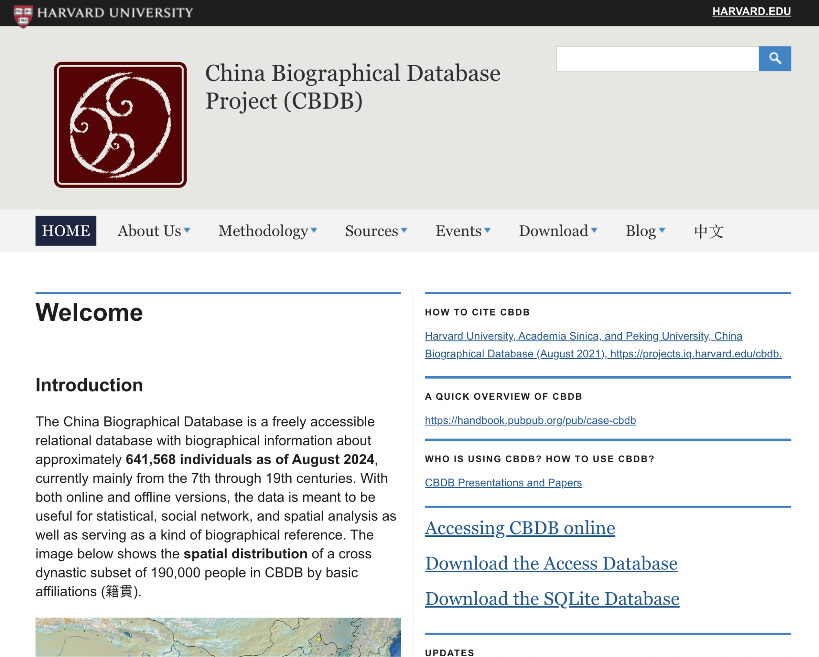
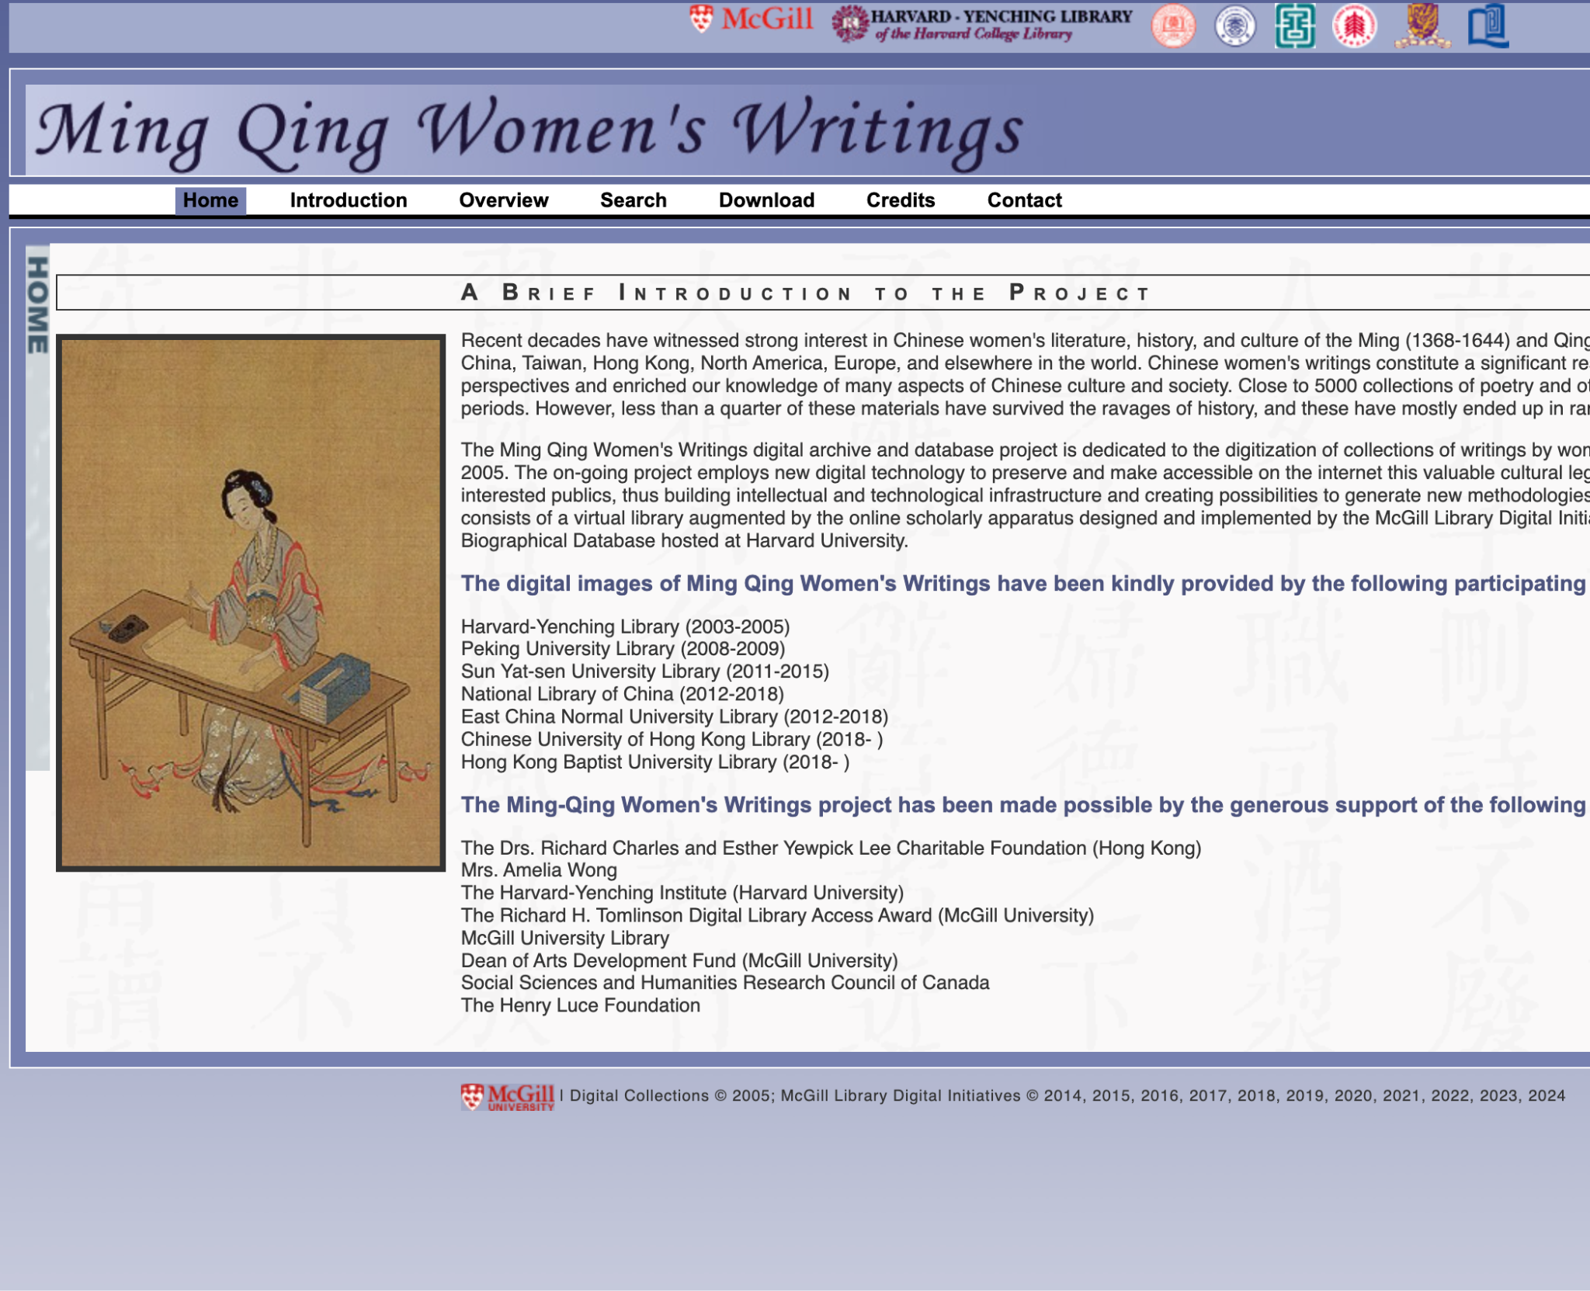
Part II: Data Introduction
China Biographical Database
Ming Qing Women’s Writings
Notes:
The data for this study comes from two main sources. The first is the China Biographical Database (CBDB), which is a comprehensive relational database containing over 600,000 biographical records of historical Chinese figures. It comprises more than 80 data tables that store both personal information and social relationship data between individuals.
The second source is the Women's Writings database, which specifically focuses on ancient Chinese female poets, documenting their biographical information and literary works. My research primarily links these two databases to connect information about female poets with the broader social network data from CBDB.

Slide 13
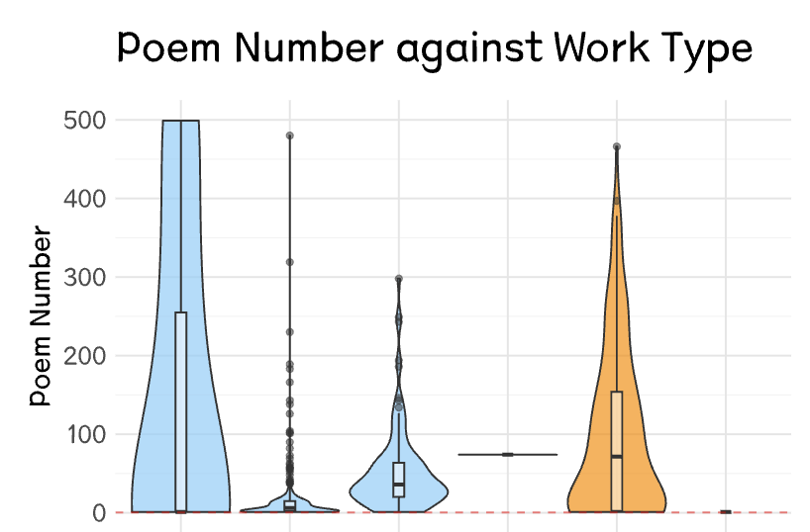
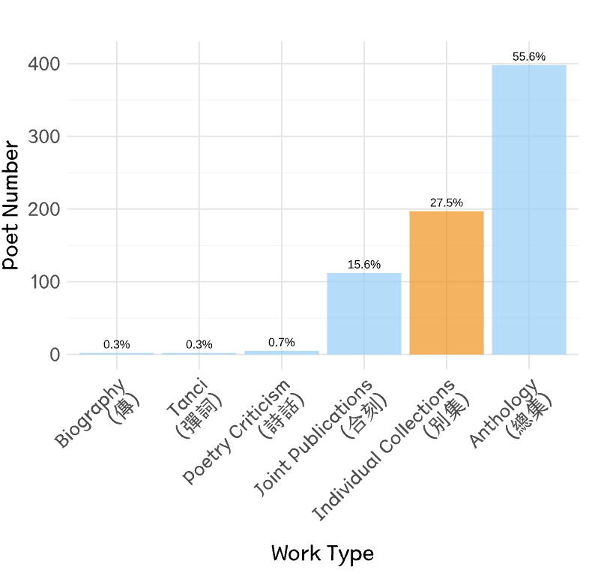
Women Poets’ Literary Recognition
For Women Poets
Biography (Zhuan/傳記)
Individual Collections (Bieji/別集)
Joint Publication (Heke/合刻)
Tanci (彈詞)
Anthology (Zongji/總集)
Poetry Criticism (Shihua/詩話)
𝑌 = 𝐼 (Bieji > 0)
Notes:
Let me explain how I measure my response variable – women's literary recognition in this study. I look at the types of publications where their works appear, with a particular focus on whether they have their own individual collections.
During this period, women's poetry could be published in two main ways: one is in anthologies alongside other authors' works (like Zongji [Anthology] 总集 and Heke [Joint Publication] 合刻), the other is in their own individual collections (Bieji 别集). Having an individual collection was especially significant - it meant their work was considered valuable enough to stand alone in a dedicated volume.
That's why I use the publication of individual collections as my measure of literary recognition. Looking at the data shown here, we can see that while most women poets were included in various anthologies, only 27% of them achieved the distinction of having their own individual collections.

Slide 14
Part II: Analysis Structure
Social Capital
Kinship
Elders; Offspring;
In-laws; Siblings
Social Relations
· Academic relations;
· Political ties;
· Literary work;
··· ···
Women’s Literary Recognition
Other Predictors
Temporal
· Historical period / dynasty
Have Individual Collections or Not
Spatial
· Administrative divisions;
· Regional educational development level
Social Status
Resource in kinship:
· Official positions;
· Social reputation;
··· ···
Notes:
My research focuses on how social capital influenced women's literary recognition in imperial China. Based on previous studies in both Chinese and Western contexts, we know that female writers historically faced significant social and economic constraints. As a result, the support of their male relatives and friends was crucial to their ability to produce work.
Look at the analysis structure shown here, I examine two main categories of variables:
First, Social Capital, which includes:
Kinship networks (which is the inborn family networks)
Social relations (academic connections, political ties, and literary circles)
There are also other predictors, ill introduce them later.

Slide 15
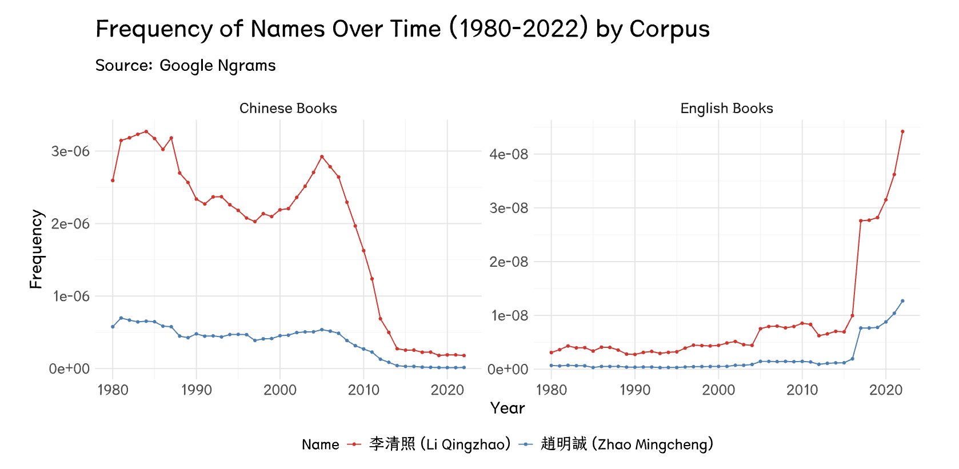
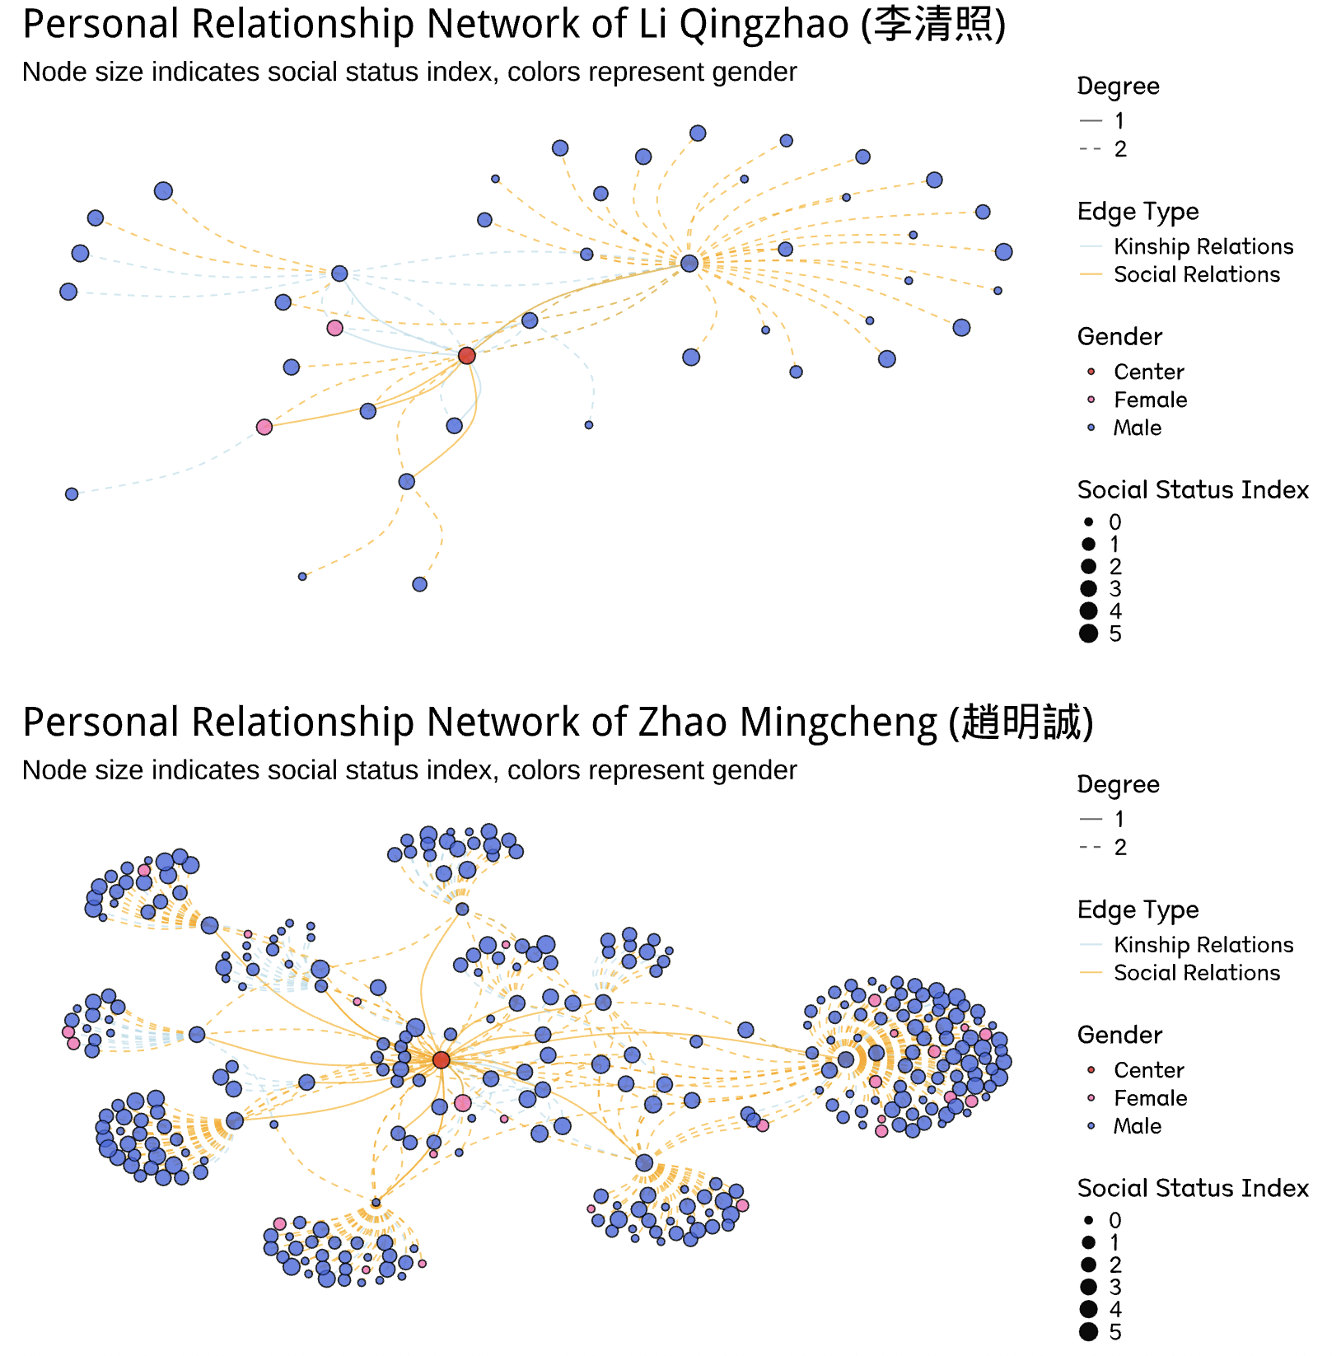
Women’s limited social capital in ancient China
Li Qingzhao had very limited social networks compared to her husband, Zhao Mingcheng, even though she is much more famous today.
Notes:
Let me show how limited women's social capital was in ancient China. I'll use the example of Li Qingzhao, a famous female poet, and her husband Zhao Mingcheng.
The left plot shows their mentions in Google Books. The red line represents Li Qingzhao, and the blue line represents Zhao Mingcheng. As we can see, Li is much more famous than her husband in modern times.
But the right plot tells a different story. It shows their social networks during their lifetime. The upper section is Li's network, and the lower section is Zhao's. Although Li is very famous in modern times, her social connections were far more limited than her husband's connections.
This case perfectly shows how even the most talented women in ancient China faced severe social constraints.

Slide 16
Part II: Social Capital Measurement
Kinship
Elders
Offspring
In-laws
Siblings
(Immediate Relatives)
Social Relations
Academic Relations
Political Ties
Social Network
Literary Work
Artistic Exchange
··· ··· (10 types)
Notes:
Now, let me explain how I measure social capital in my research. I focus on two main categories of relationships:
First, Kinship Networks:
These are immediate family connections
Including parents, siblings, spouse, and children
Also covering in-laws and close relatives
Second, Social Relations:
These extend beyond family ties
Including ten types of relationships, such as:
Academic connections (like teacher-student relationships)
Literary collaborations
Political associations
Friendships
And other social ties

Slide 17
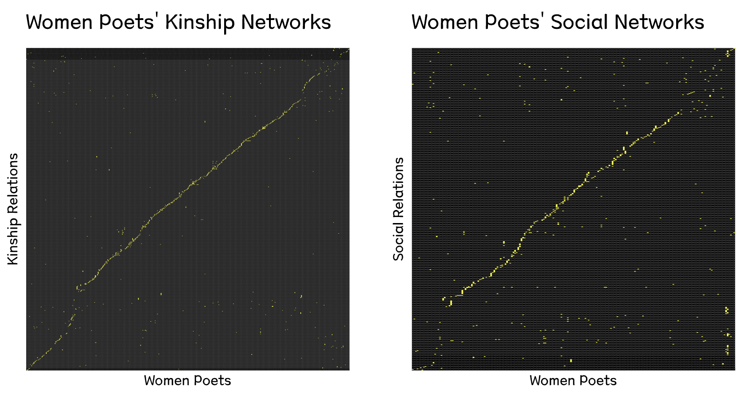
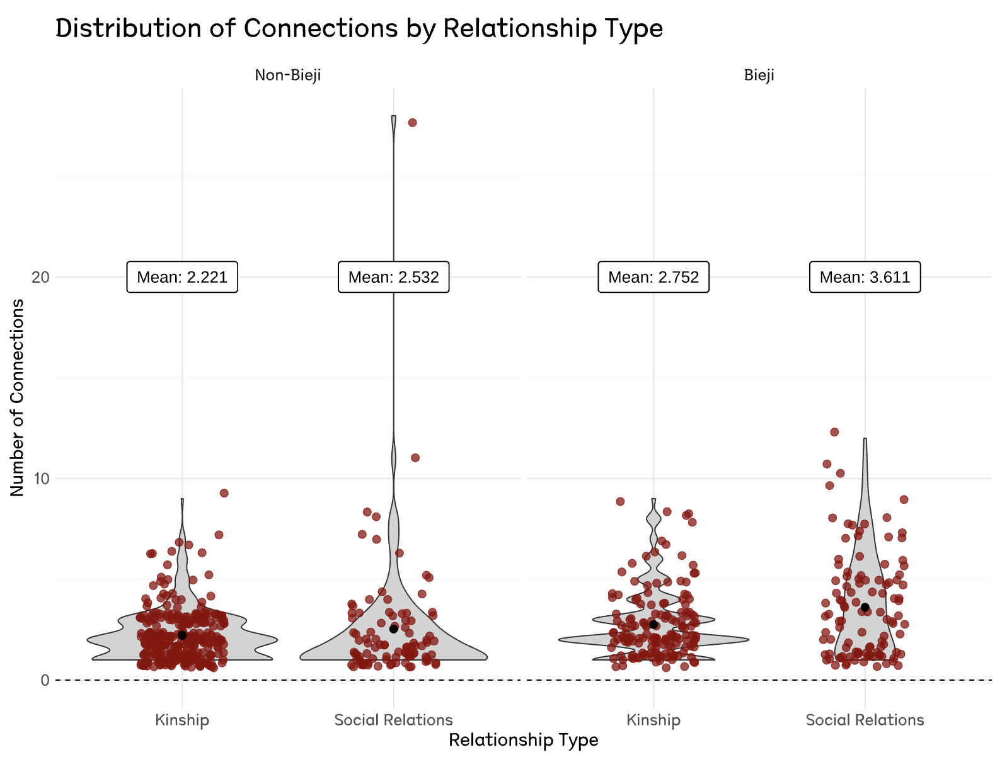
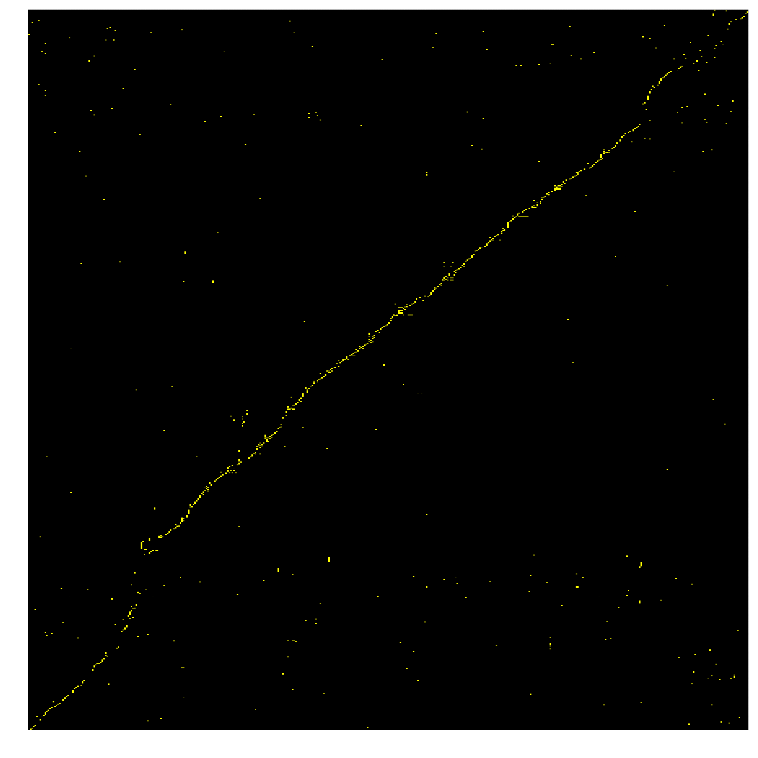
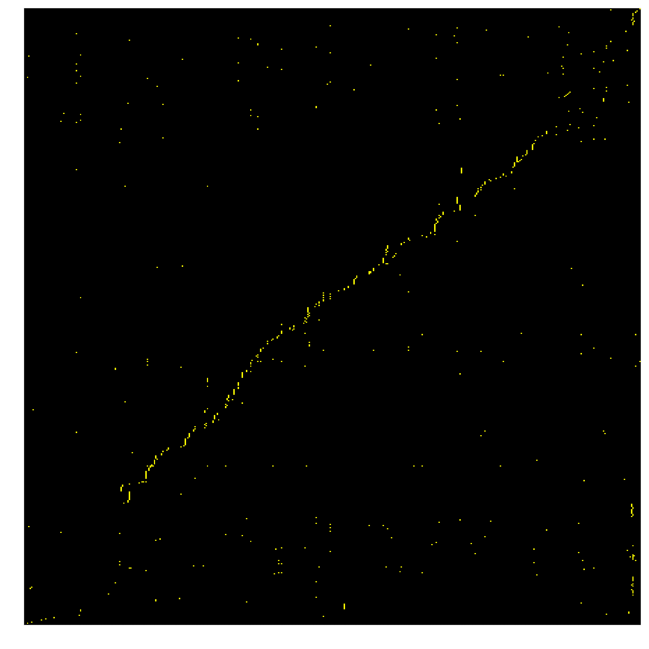
Social Capital
The connections in kinship relations are significantly richer than those in social networks.
Women who have individual collections have higher mean connection values.
Notes:
Let me show you an overview of women poets' social capital based on our data.
On the left is a network adjacency matrix. The x-axis shows the women poets, while the y-axis shows their connections to different individuals. Each dot represents a connection. This plot shows that kinship relations show much richer connections than social networks
The right plot compares the distribution of connections between two groups - poets with and without individual collections. It's divided by relationship types. It shows that regardless of the relationship types, women who have individual collections have higher mean connection values

Slide 18
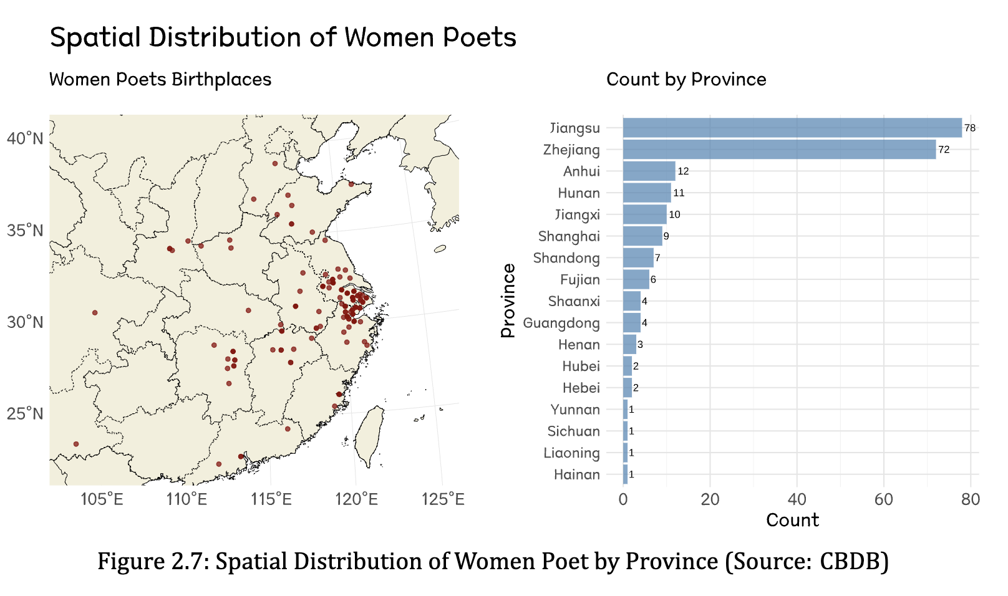
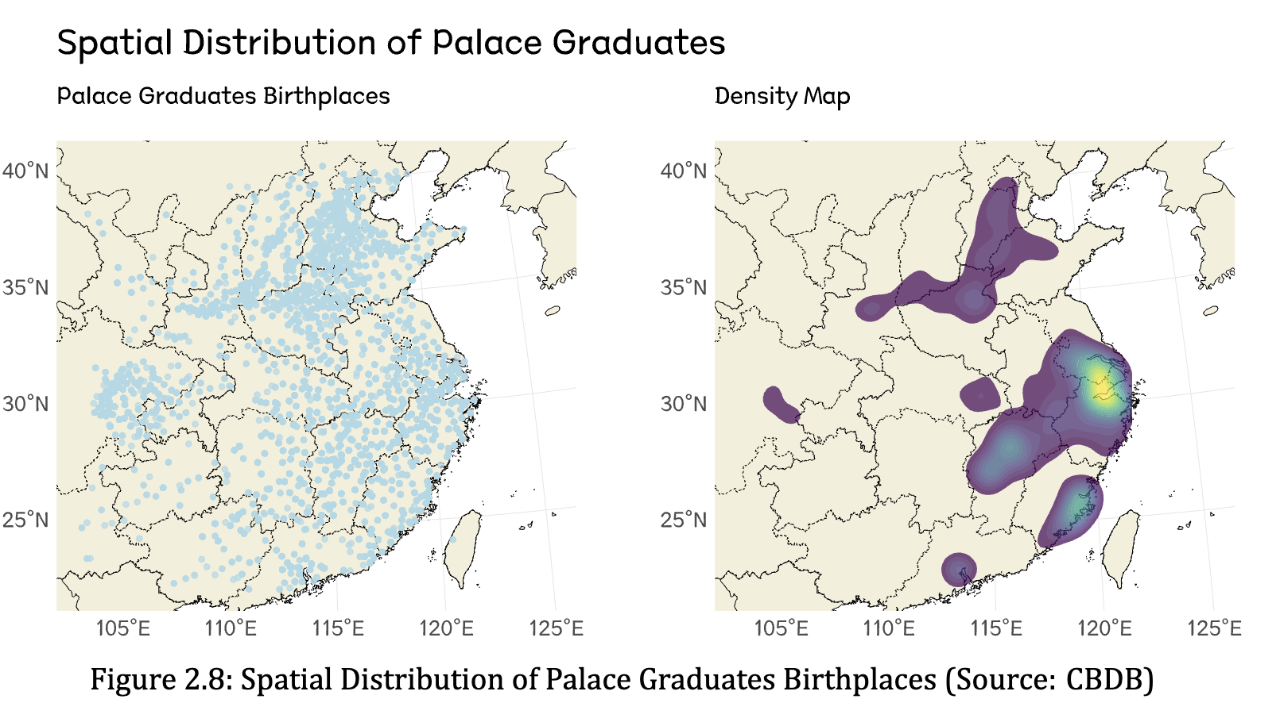
Control Variables: Location
Administrative Provinces:
the different structural mechanisms within those regions.
Local Education Level:
approached by the number of Jinshi in that region.
Notes:
Besides social capital, I also controlled for other factors that may impact the response.
In terms of spatial factors, I controlled for the administrative provinces of the women poets' birthplaces. As shown in the plot on the right, some provinces had significantly more women poets than others, which can be attributed to the structural mechanisms within those regions.
Additionally, I controlled for the local education level. This was approached by examining the number of successful candidates in the imperial examination (jinshi) in the area around the time of the poets' births. A higher number of jinshi can be interpreted as an indication of more advanced local education level in that region.

Slide 19
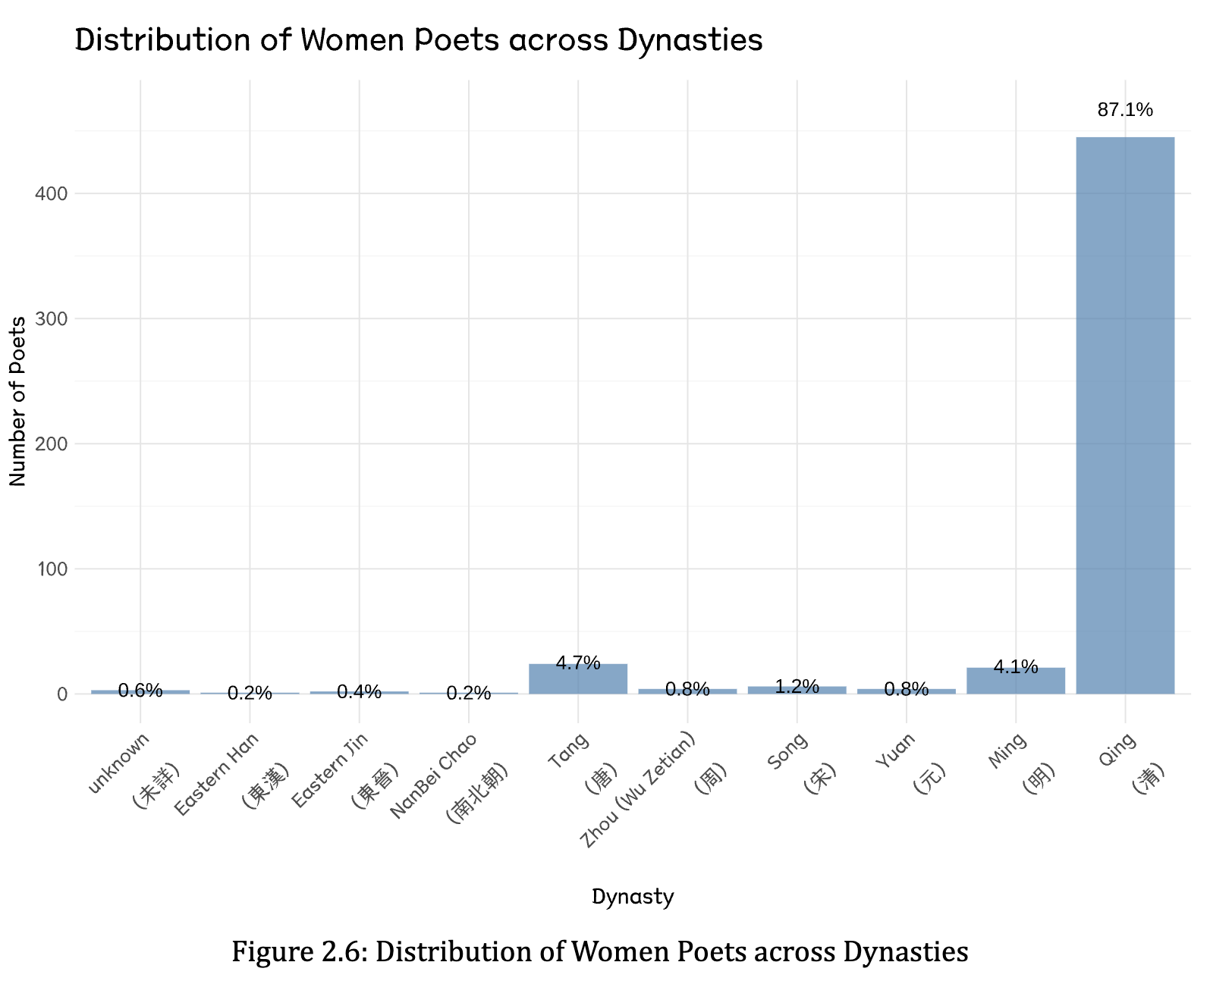
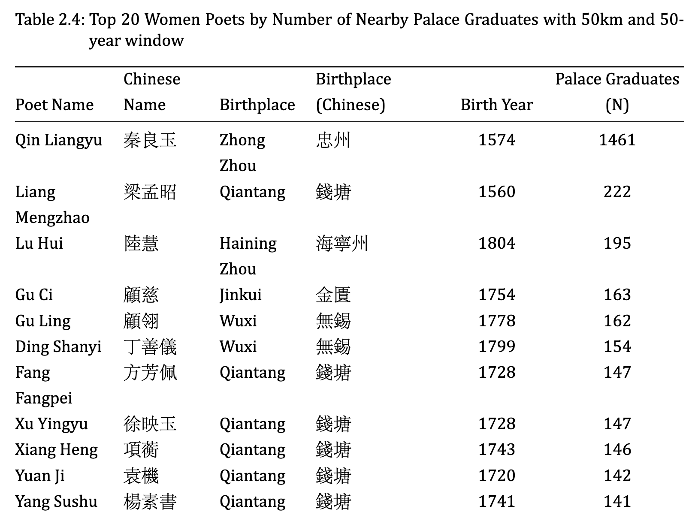
Control Variables: Period
Notes:
In the database, the distribution of women poets spans different historical periods from the Eastern Han to the Qing Dynasty. Different dynasties may have varying influences, so the dynasty is also taken into account as an important variable.

Slide 20
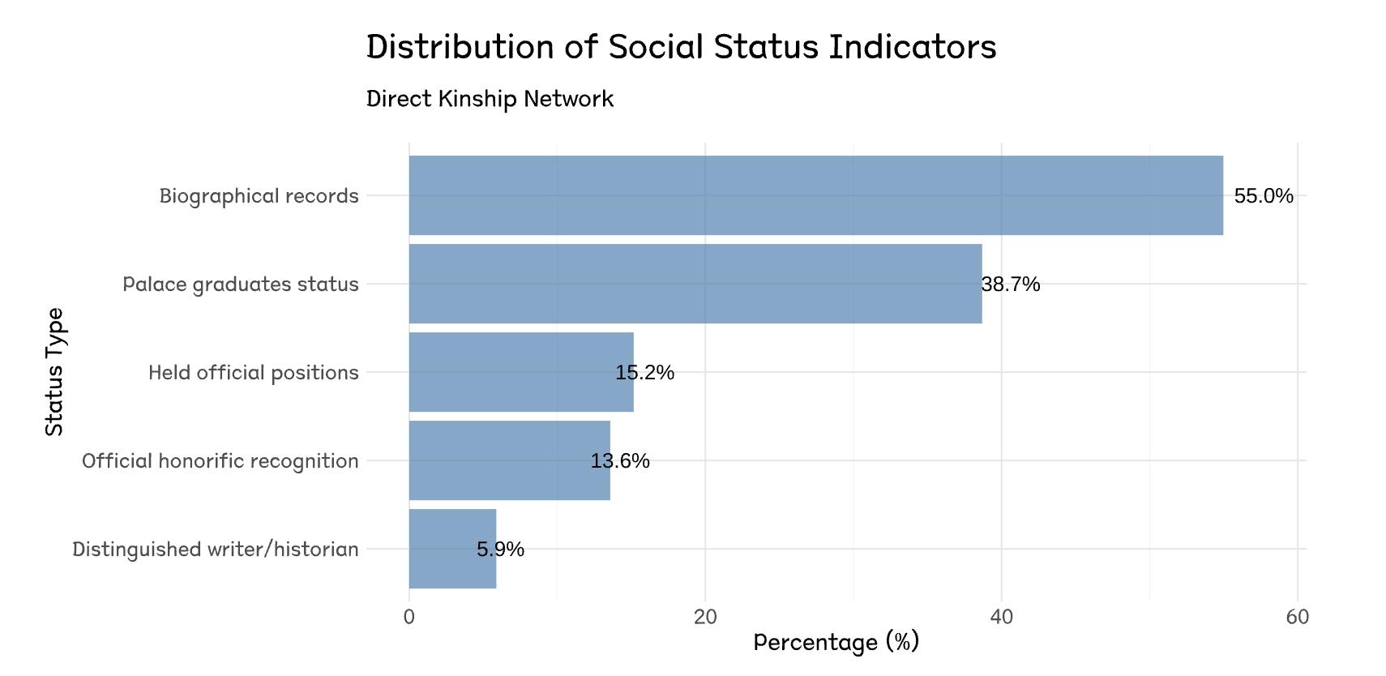
Control Variables: Social Status
Notes:
I also controlled for women’s social status by assessing their families' social and economic standing. This includes whether family members held official positions or were distinguished writers or historians.

Slide 21
Part II: Analysis Structure
Social Capital
Kinship
Elders; Offspring;
In-laws; Siblings
Social Relations
· Academic relations;
· Political ties;
· Literary work;
··· ···
Women’s Literature Recognition
Other Predictors
Temporal
· Historical period / dynasty
Have Individual Collections or Not
Spatial
· Administrative divisions;
· Regional educational development level
Social Status
Resource in kinship:
· Official positions;
· Social reputation;
··· ···
Notes:
Let’s return to my analysis structure. I will measure the impact of these variables on women’s literary recognition.
Since the number of predictors is much greater than the number of observations, I chose Lasso as my main analysis models.
I break down my analysis into three steps to show how different relationships shaped women's literary success.

Slide 22
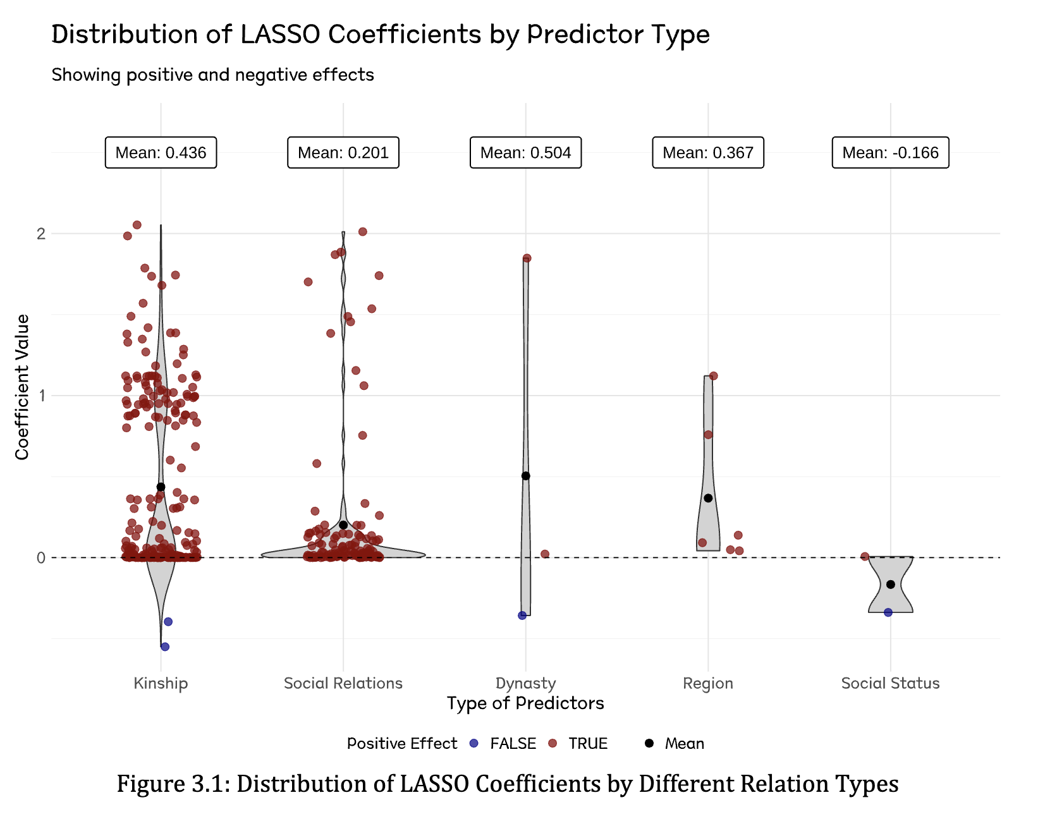
Step 1 Lasso Regression: Individual Effects Within Networks
Many individuals in kinship and social relations have a positive impact.
The mean coefficient for kinship is significantly larger than that of social relations.
The coefficients for the spatial and temporal variables are greater than those for social relations.
Notes:
Let's look at my first analysis step. I used a Lasso model where each relationship is coded as a binary variable - either 0 or 1. This helps us see the individual effects of each connection.
The plot on the right shows what we found:
Both kinship and social ties helped women get literary recognition
But here's the interesting part: family connections (kinship) had a much stronger mean impact than social relationships

Slide 23
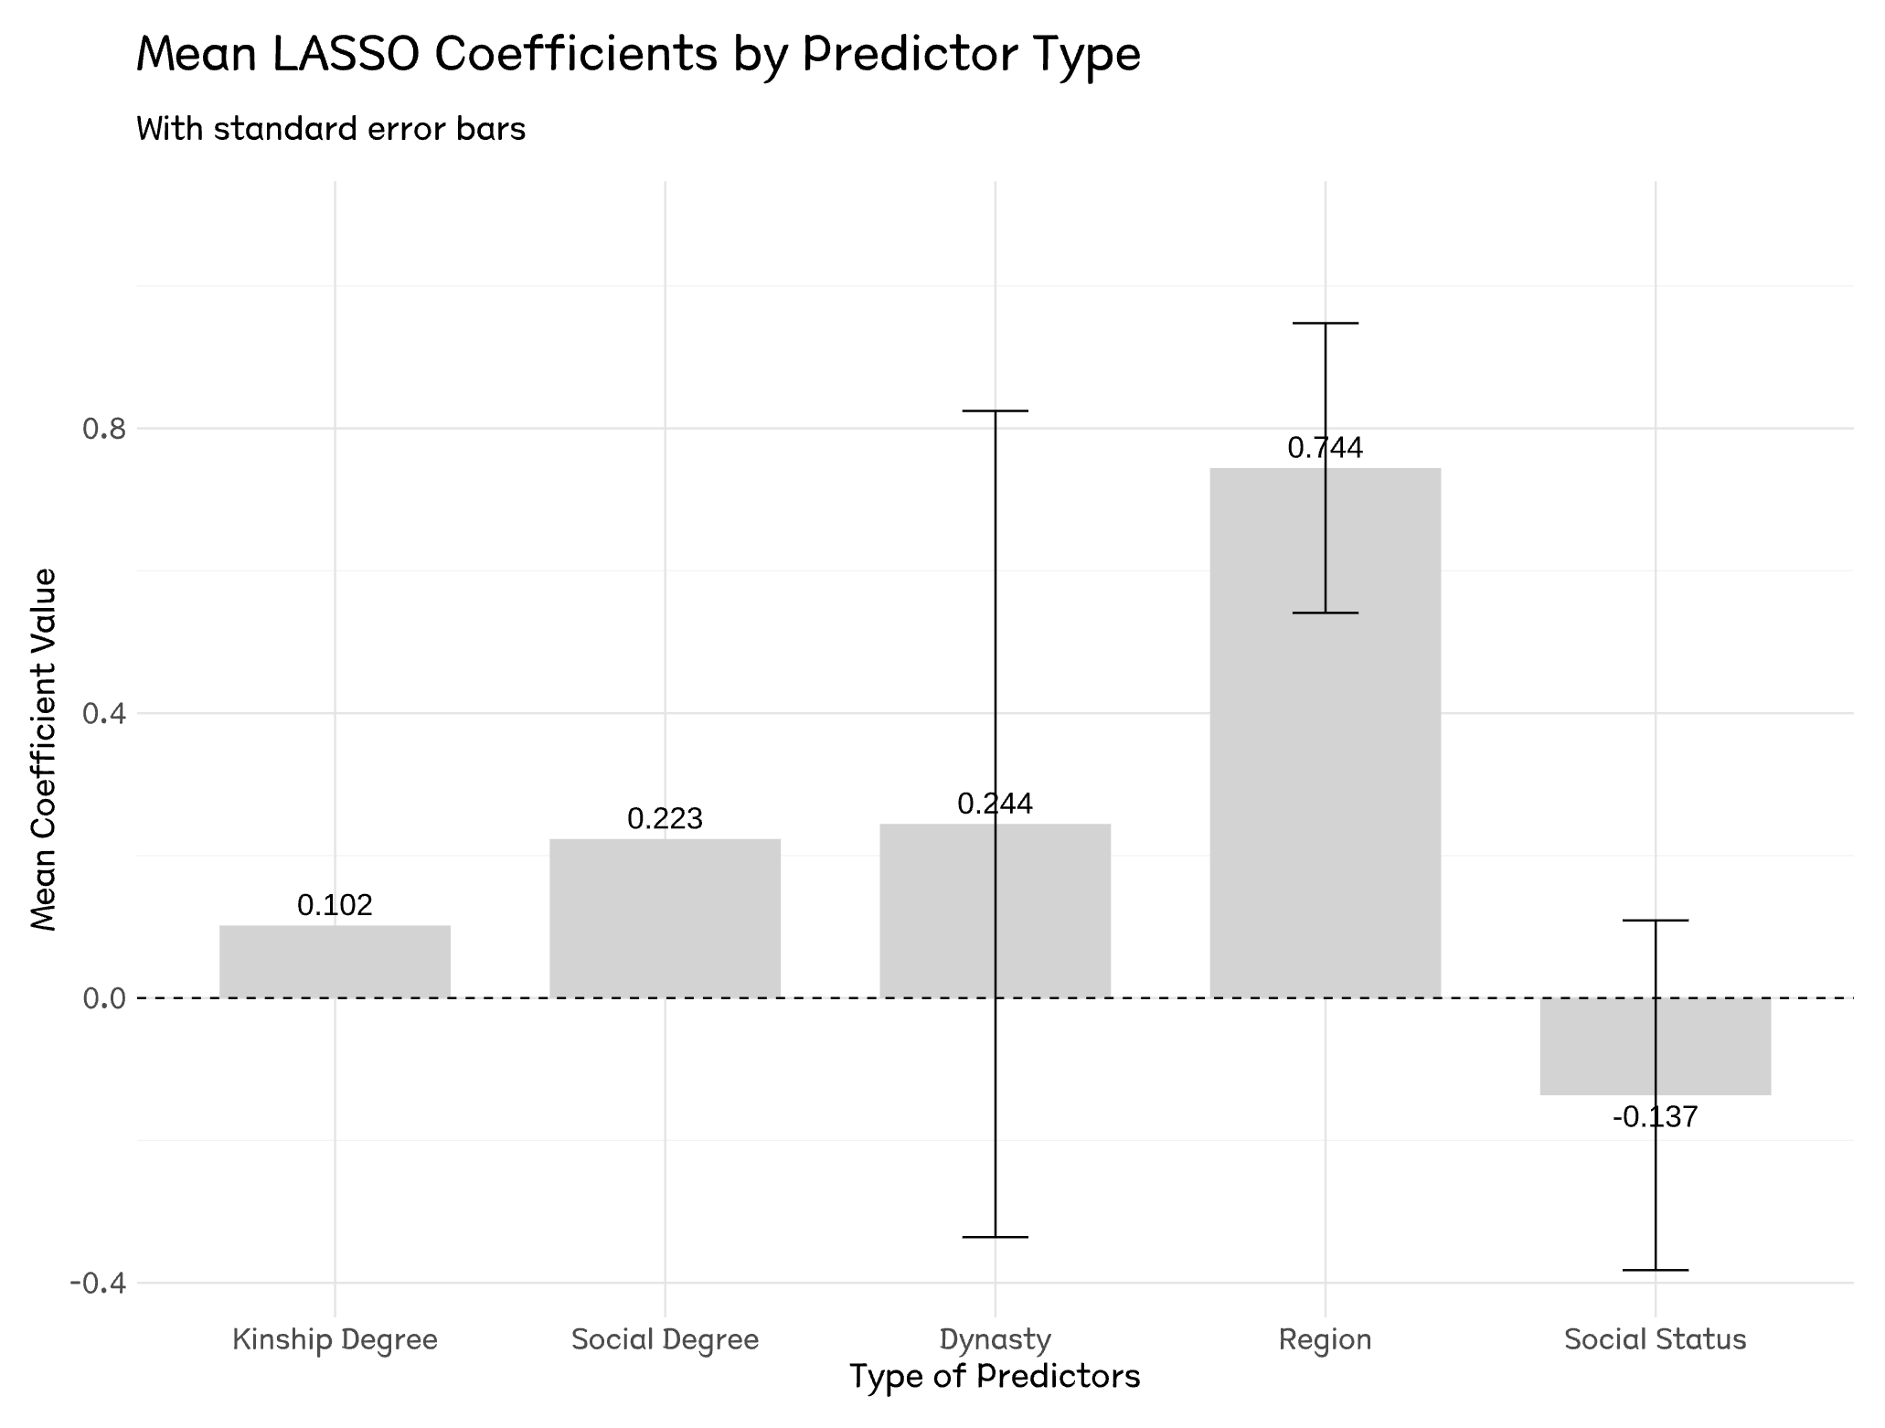
Step 2 Lasso Regression: Centrality Effects in Networks
Kinship Degree (0.102)
Social Degree (0.223)
When considered as an aggregated indicator rather than simply calculating the mean of individual networks, the coefficient for social degree is higher than that of kinship.
Notes:
For my second step, I changed how I measured connections. Instead of looking at individual relationships, I used a network measure called 'degree' For each woman poet, I calculated her total number of connections
The results show an interesting result: Social connections (0.223) had twice the impact of family ties (0.102)
This reveals something crucial: when we look at the bigger picture of network effects, social connections proved more powerful than family ties.

Slide 24
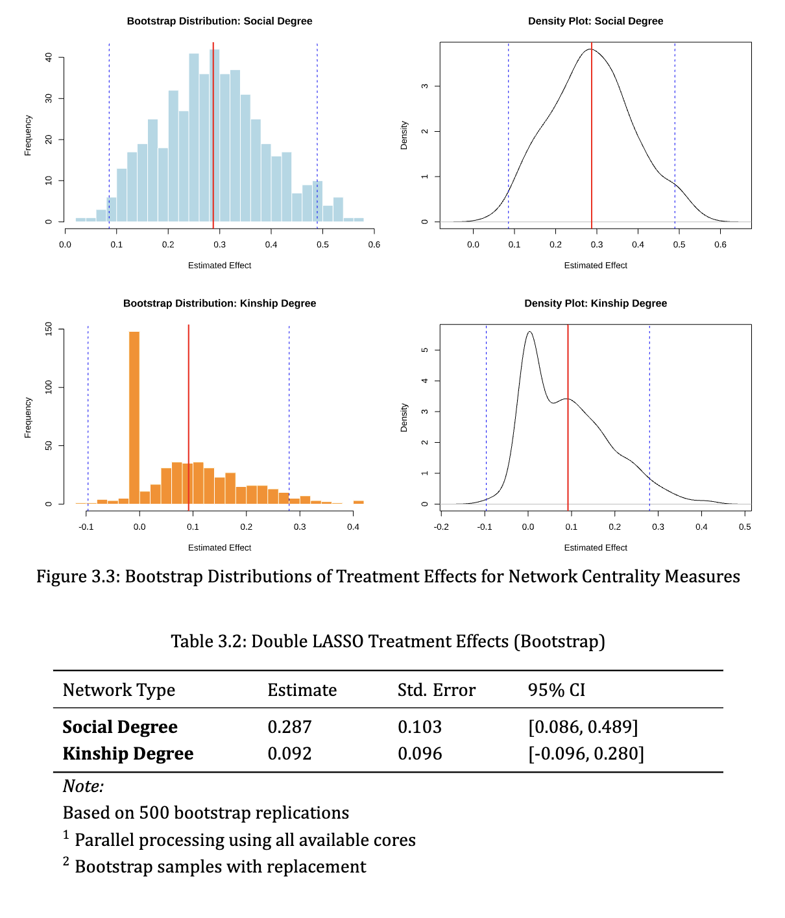
Step 3 Double Lasso: Causal Effects in Networks
Social degree effect:
statistically significant with an estimated coefficient of 0.287 (95% CI: [0.086, 0.489]).
Kinship degree effect:
statistically insignificant with an estimate of 0.092 (95% CI: [-0.096, 0.280]).
Notes:
However, the coefficients from step two don't tell us the true network effects. For the final step, I used Double Lasso to identify the actual causal effects.
First, I separated out the influence of all other variables on both social and kinship degrees
Then, I put these adjusted measures back into a Lasso model
This helps us get a clearer picture of the true network effects
The results confirm and strengthen our earlier findings:
Social connections show a strong and statistically significant effect (0.287)
In contrast, family ties is not statistically significant
This gives us more confidence in our key finding: social networks were indeed more crucial for women's success than family connections.
---------
---------
This is a good question. Let me explain from my perspective:
First, the main difference is simple: you are born into your family network - you don't choose it. But social networks are different. You need to build them yourself.
Second, yes, in ancient china, family ties might have helped women make social connections. But my research has considered it. I used double lasso method to separate the effects. What we found was clear: even after we removed all family-related effects, women's social connections still had a stronger positive impact on their success.
I hope this helps explain.

Slide 25
Conclusion
Main Finding:
Social Connections Matter Most: The social relation network has a significantly positive effect on women's literary recognition, whereas the kinship network does not
What This Means:
For women, building broader social connections was more crucial for success than relying on family ties.
Notes:
Let me share our key finding.
What really mattered for women's literary recognition? Our analysis shows that social networks made the real difference. While social connections had a significant positive effect on women's literary success, family ties did not show significant impact.
This is particularly interesting because in traditional Chinese society, women were typically thought to rely on male family members for success. This study shows that it was actually their broader social connections, not family ties, that proved crucial for their literary recognition.

Slide 26
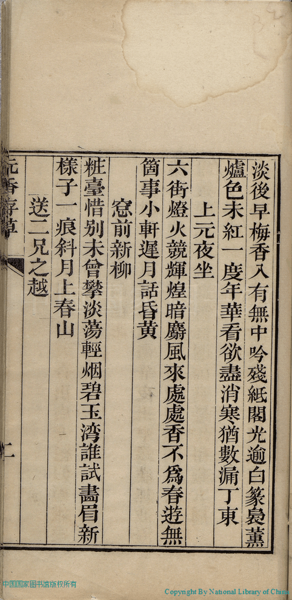
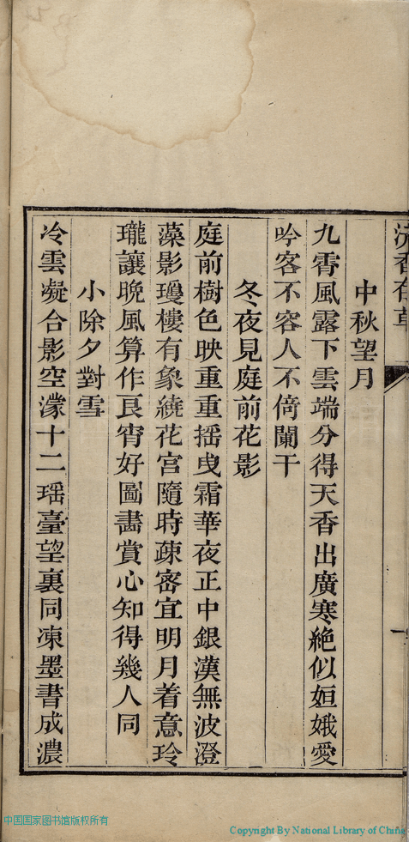
Afterword
Many women didn’t left behind their own names in the data;
they were recorded only as 'Zhou Shi 周氏 (Mrs. Zhou)' or 'Li Shi 李氏 (Mrs. Li)', which means 'one woman who married into the Zhou or Li family.
The evidence they left behind spans centuries;
reminding us that a woman's worth must be created by herself and not defined by her family.
Notes:
Finally, I'd like to share some feeling during this research
While collecting data, I discovered many women didn't have their names, they were recorded only as 'Zhou Shi' or 'Li Shi' - which means 'one who married into the Zhou or Li family. They created excellent poetry, but they didn’t leave their own names in history.
However even in an era when women's value was entirely overlooked, they still made every effort to record their lives, emotions, and aspirations, even though most of them left behind no names.
And The evidence for me it’s the data they left behind spans centuries, reminding us that a woman's worth must be created by herself and not defined by her family.

Slide 27
References
Bourdieu, P. (1986). The forms of capital. In J. Richardson (Ed.), Handbook of Theory and Research for the Sociology of Education (pp. 241-258). New York: Greenwood.
Coleman, J. S. (1988). Social capital in the creation of human capital. American Journal of Sociology, 94, S95-S120.
Granovetter, M. S. (1973). The Strength of Weak Ties. American Journal of Sociology, 78(6), 1360-1380.
Burt, R. S. (1992). Structural Holes: The Social Structure of Competition. Harvard University Press.
Lin, N. (2001). Social Capital: A Theory of Social Structure and Action. Cambridge University Press.
Bian, Y. (1997). Bringing Strong Ties Back In: Indirect Ties, Network Bridges, and Job Searches in China. American Sociological Review, 62(3), 366-385.
Campbell, C., & Lee, J. Z. (2000). State views and local views of population: Linking and comparing genealogies and household registers in Liaoning, 1749-1909. History and Computing, 12(1), 51-76.
Zelin, M. (2005). The Merchants of Zigong: Industrial Entrepreneurship in Early Modern China. Columbia University Press.
Deng, Z., & Treiman, D. J. (2008). The Impact of the Cultural Revolution on Trends in Educational Attainment in the People's Republic of China. American Journal of Sociology, 114(2), 391-428.
Wong, S. (2011). Kinship, Business and Elite Formation in Chinese History. Cambridge University Press.
Ko, D. (1994). Teachers of the Inner Chambers: Women and Culture in Seventeenth-Century China. Stanford University Press.
Mann, S. (1997). Precious Records: Women in China's Long Eighteenth Century. Stanford University Press.

Slide 28
References
Wu, P. (2003). The Confucian's Progress: Autobiographical Writing in Traditional China. Princeton University Press.
Robertson, M. (1992). The Art of Letter-Writing: An Essay on the Handscrolls of Ming and Ch'ing Women. Late Imperial China, 13(1), 1-50.
Fong, G. S. (2004). Female Hands: Embroidery as a Knowledge Field in Women's Everyday Life in Late Imperial and Early Republican China. Late Imperial China, 25(1), 1-58.
Banerjee, A., Chandrasekhar, A. G., Duflo, E., & Jackson, M. O. (2013). The Diffusion of Microfinance. Science, 341(6144), 1236498.
Belloni, A., Chernozhukov, V., & Hansen, C. (2014). Inference on Treatment Effects after Selection among High-Dimensional Controls. Review of Economic Studies, 81(2), 608-650.
Chatterjee, A., & Lahiri, S. N. (2011). Bootstrapping Lasso Estimators. Journal of the American Statistical Association, 106(494), 608-625.
Harvard University. (2024). China Biographical Database (CBDB).
Knight, K., & Fu, W. (2000). Asymptotics for Lasso-Type Estimators. Annals of Statistics, 28(5), 1356-1378.
Liu, H., Xu, X., & Li, J. J. (2020). A Bootstrap Lasso+ Partial Ridge Method to Construct Confidence Intervals for Parameters in High-Dimensional Sparse Linear Models. Statistica Sinica, 30(3), 1333-1355.
Mazanec, T. J. (2018). Networks of Exchange Poetry in Late Medieval China: Notes Toward a Dynamic History of Tang Literature. Journal of Chinese Literature and Culture, 5(2), 322-359.

Slide 29
Thank you
Q & A
Notes:
This is a good question. Let me explain from my perspective:
First, the main difference is simple: you are born into your family network - you don't choose it. But social networks are different. You need to build them yourself.
Second, yes, in ancient china, family ties might have helped women make social connections. But my research has considered it. I used double lasso method to separate the effects. What we found was clear: even after we removed all family-related effects, women's social connections still had a stronger positive impact on their success.
I hope this helps explain.

